Slide 1
Data analysis for hotels using R Language

Slide 2
Agenda
Introduction
Data cleaning
Questions
Analyzing/visualization
Insights

Slide 3
Introduction
We have hotels dataset full of information and mystery. When the best time of year to book a hotel room is? Or the optimal length of stay in order to get the best daily rate?
This hotel booking dataset can help you explore those questions!

Slide 4

Data Cleaning​
Made a data frame that only has cancelled reservation.
Made a data frame that only has noncancelled reservation.
Made a data frame that has adr_mean

Slide 5
Questions
What is the relation between waiting list days and cancellation rate?
What hotel has the most reservations?
What is the relation between deposit type and cancellation rate?
What is the most profitable month of the year?

Slide 6
Analyzing and visualizing

Slide 7
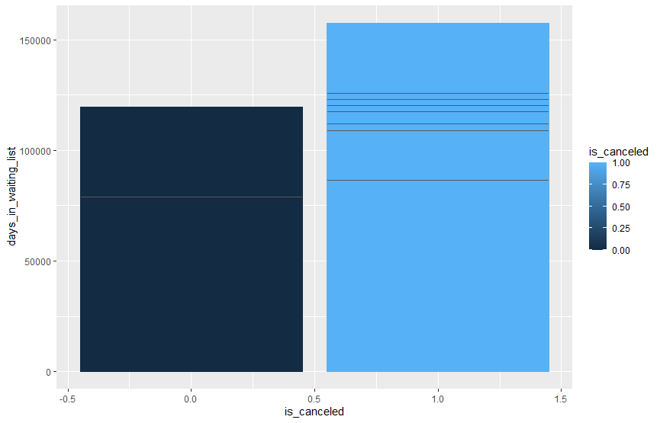
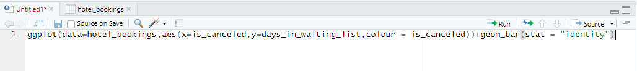
Bar chart waiting_list_days/is_Cancelled

Slide 8
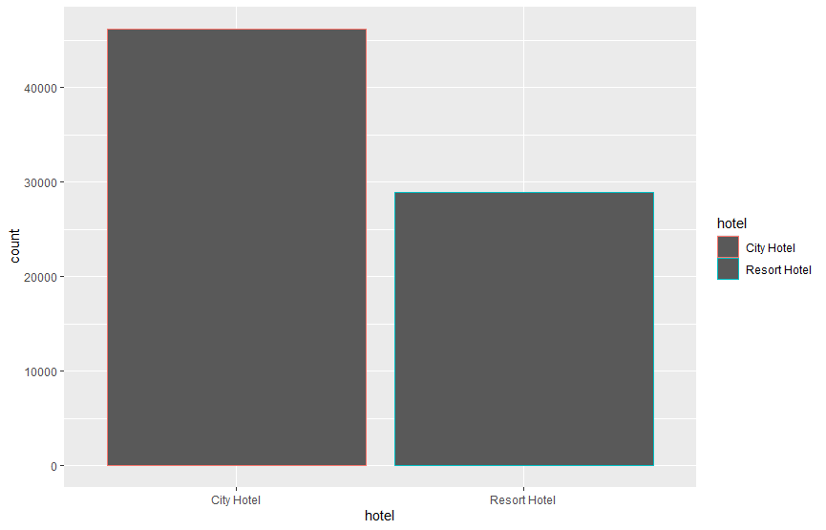
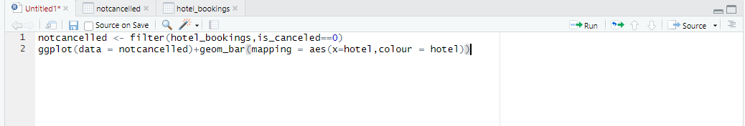
Bar chart Hotel/number of reservations

Slide 9
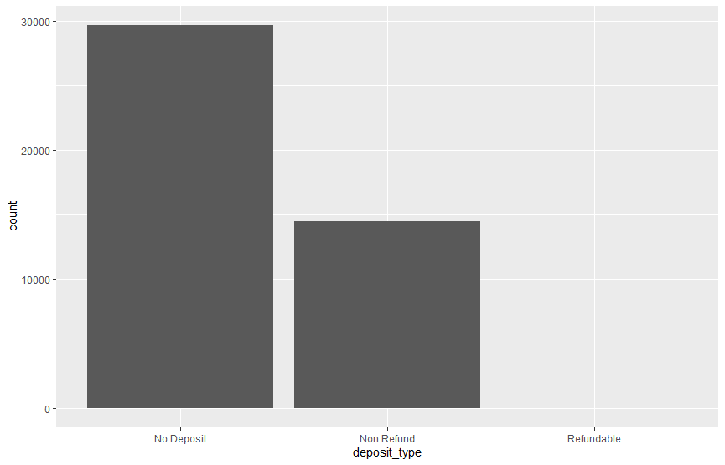
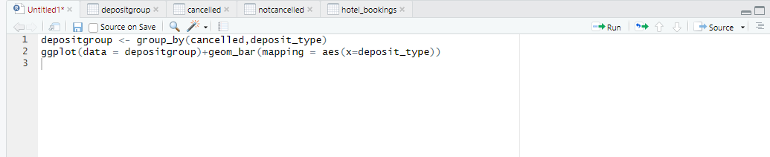
Bar chart Deposit_type/number of cancelations

Slide 10
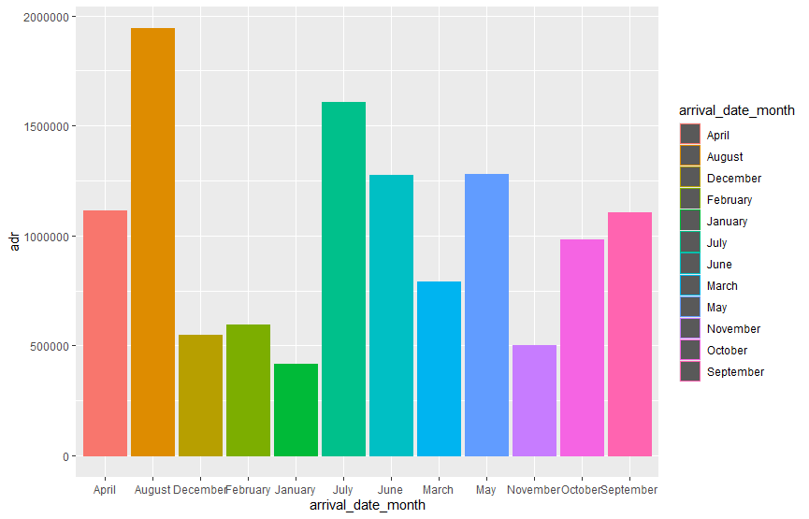
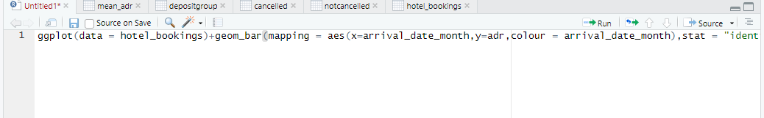
Bar chart month/adr(average daily rate)

Slide 11
Insights​
As the waiting days increases # of cancellation also increases
City Hotel has the most reservations
No Deposit type has the highest cancellation rate
August is the most profitable month

Slide 12
THANK YOU

